Slide 1

Final Project Presentation for Student Portal
The Final Software Project final project
Be Huynh
University of Arizona Global Campus
CST499: Capstone for Computer Software Technology
Professor Joseph Rangitsch
March 3, 2025

Slide 2
Introduction
Key aspects of the SRS document.
Showcase the UML design model.
Design of the landing, login, and enrollment pages.
The MySQL database and class registration.
The PHP code.

Slide 3
Software Requirements Specification (SRS)
Purpose: Specific functional and non-functional requirements for the student portal system.
Student Course Enrollment System, focusing on course registration, scheduling, and waiting lists.
Project Scope: Aims to streamline student course registration and improve efficiency.
Features: User Registration and authentication, login, course enrollment, waitlist management, and notifications.
Users: Students, instructors, and administrations

Slide 4
Functional and non-functional requirements
Functional Requirements
User registration and login, course enrollment, waitlist management, and cancellations.
Course Management – List available courses, allow enrollment, cancellations, and waitlisting.
User Authentication – Register, log in, and update profiles securely.
Error Handling – Show errors for invalid enrollments.
Admin Functions – Manage courses, students, and technical support.
Notifications – Send emails for enrollment updates.
Integration – Connect with student records and payment systems.
Non-Functional Requirements
Support many users at once, keep data safe, and make the system easy to use.
Performance – Fast loading (2s), quick enrollment, and search results (3s).
Security – Data encryption, secure login, and access control.
Reliability – 99.9% uptime, scalable, and easy to maintain.
Compatibility – Works on major browsers and mobile devices.

Slide 5
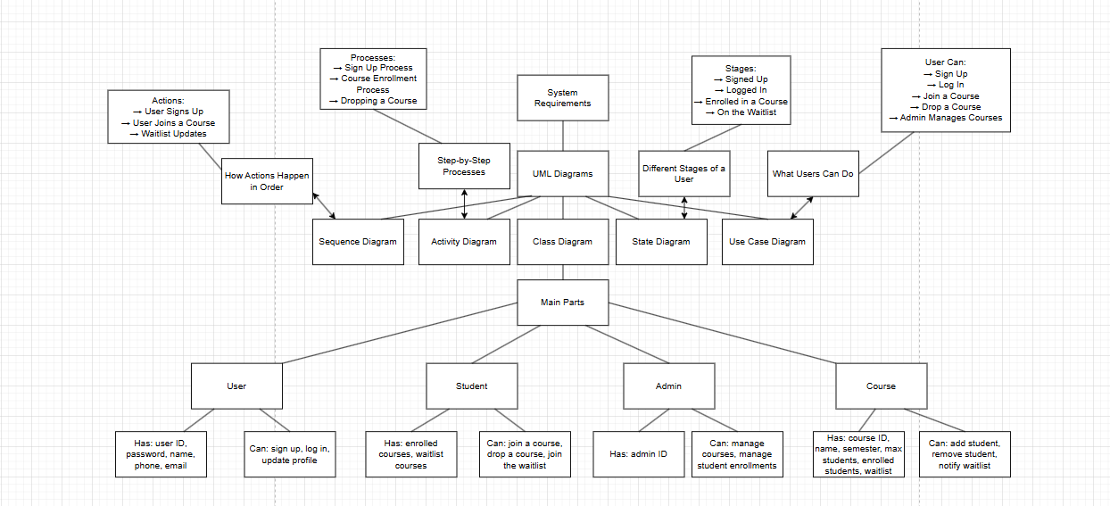
Showcase the UML design model:

Slide 6
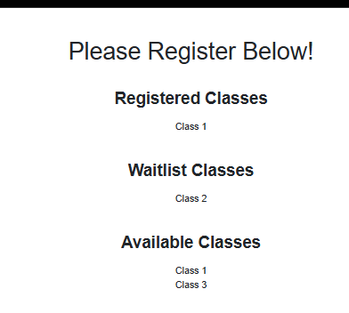
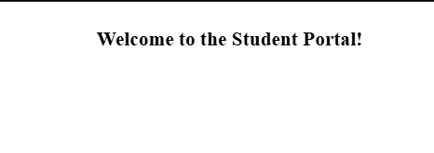
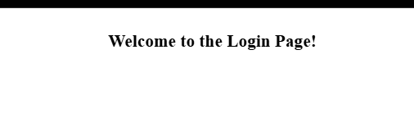

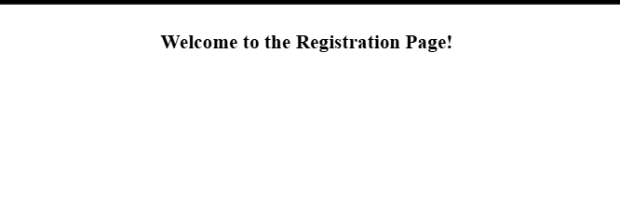


Landing, login, and enrollment pages.
MySQL database and class registration.
Landing Page:
Clear layout for easy reading
Simple navigation to key sections
Login:
Check inputs to prevent errors
Keep passwords safe
Enrollment:
Easy course selection
Waitlist option for full courses
Quick confirmation messages

Slide 7
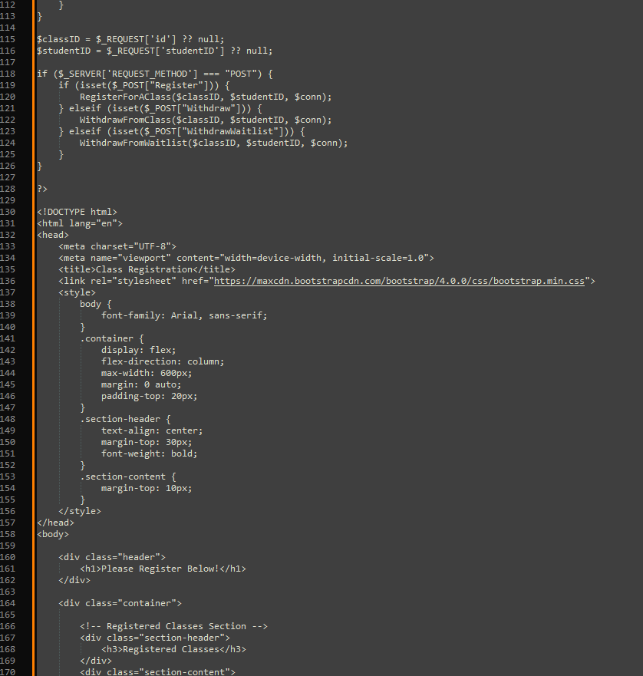
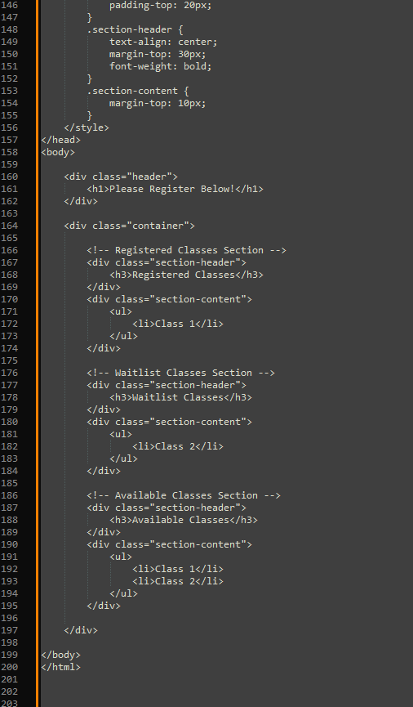
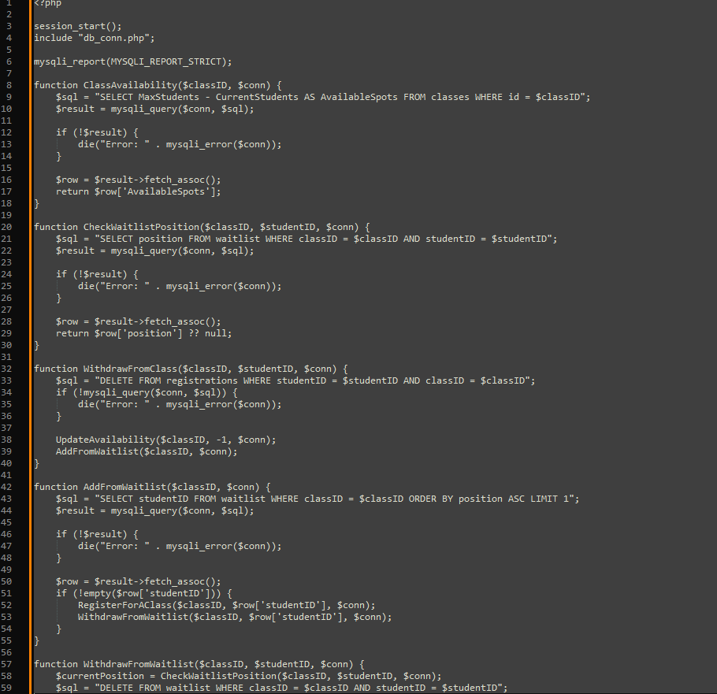
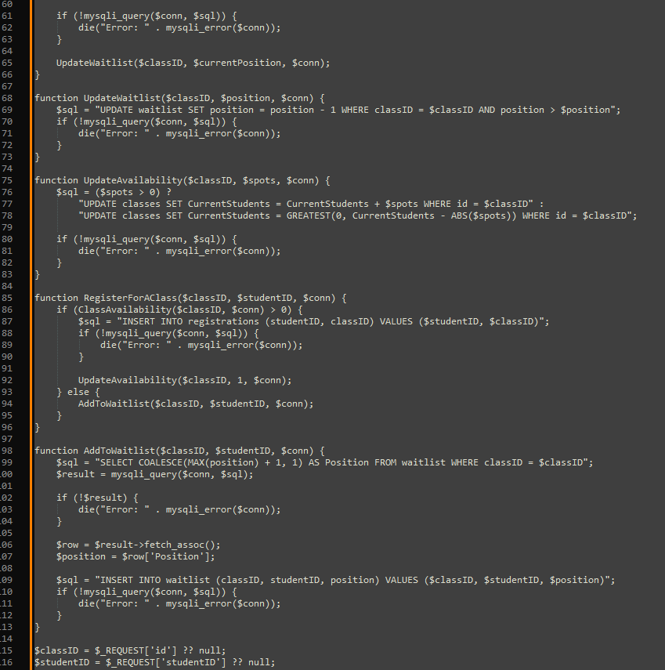
PHP code
1. User Enrollment
A student selects a course.
The system checks if there are available seats.
If seats are available, the student is enrolled, and their details are saved in a database.
2. Waitlist Handling
If the course is full, the system adds the student to a waitlist.
When a spot opens (e.g., another student drops the course), the system moves the next student from the waitlist into the course.
3. Login & Security 4. Notifications
Students log in using a username and password.
The system verifies login details before granting access. The system confirms successful enrollment.
Passwords are securely stored using encryption. Waitlisted students get notified if they are moved into the course.

Slide 8
Wrapping it up….
Software Requirements Specification (SRS) Document: This document defines what the system should do and how it should function. I initially created it in Week 1 and continuously updated it to align with user needs and technical requirements.
UML Design Model: Developed in Week 2, this model visually represents the system’s structure and interactions, helping to organize its components and ensure a well-structured final product.
Landing, Login, and Enrollment Pages: In Week 3, I designed and implemented these key user-facing pages. The landing page serves as the entry point, the login page ensures secure access, and the enrollment page allows students to register for classes.
MySQL Database and Class Registration: In Week 4, I built a MySQL database to store student data, courses, and enrollments. The class registration system enables students to sign up for classes while keeping data organized and secure.
PHP Code: I developed PHP scripts to handle user authentication, form submissions, and database interactions. This backend logic ensures smooth communication between the front-end interface and the database, making the system functional and efficient.
Overall, this presentation provides an overview of each part of the system and demonstrates how they all work together to create a student enrollment portal.

Slide 9
References:
Course enrolment - MoodleDocs. (n.d.). https://docs.moodle.org/405/en/Course_enrolment
Differences between the different levels & types of testing. (2023, August 24). Reqtest. https://reqtest.com/en/knowledgebase/different-levels-of-testing/
GeeksforGeeks. (2024, February 25). Levels of software testing. GeeksforGeeks. https://www.geeksforgeeks.org/levels-of-software-testing/
GeeksforGeeks. (2024, June 5). How to insert form data into database using PHP? GeeksforGeeks. https://www.geeksforgeeks.org/how-to-insert-form-data-into-database-using-php/
GeeksforGeeks. (2020, November 2). PHP database connection. GeeksforGeeks. https://www.geeksforgeeks.org/php-database-connection/
How Fast Should A Website Load? (n.d.). Retrieved February 3, 2025, from https://Https://pagespeedchecklist.com/load-time-goals
Hosting, S. W. (2021, August 17). PhpMyAdmin database management tutorial. SiteGround. https://www.siteground.com/tutorials/phpmyadmin/database-management/
Menon, K. (2024, July 10). PHP with MySQL: Ultimate step-by-step guide. Simplilearn.com. https://www.simplilearn.com/tutorials/php-tutorial/php-with-sql
Tsui, F., Karam, O., & Bernal, B. (2018). Essentials of software engineering (4th ed.). Jones & Bartlett Learning.
Wolford, B. (2024, August 29). What is GDPR, the EU’s new data protection law? GDPR.eu. https://gdpr.eu/what-is-gdpr/

Slide 10
Thank you!
By Be Huynh

